Slide 1
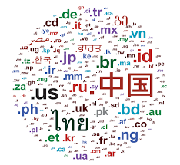
LANGUAGE DETECTION USING NATURAL LANGUAGE PROCESSING
Presented by :
19K41A0555-R.AKSHAY
19K41A0559-T.VINAY KUMAR
19K41A04A0-J.ADITI

Slide 2
Content
Introduction
applications
Problem OBJECTIVES
DATASET INSIGHT
methodology
procedure
results
conclusion
LITERATURE REVIEW
references

Slide 3

introduction
Language detection is a natural language processing task where we need to identify the language of a text or document.
As a human, we can easily detect the languages we know. For example, we can easily identify Telugu,Hindi and English, but being an Indian, it is also not possible for us to identify all Indian languages and language used across the world.
This is where the language identification task can be used. Google Translate is one of the most popular language translators in the world which is used by so many people around the world.

Slide 4
APPLICATIONS
The language detection service is used to identify the language of business texts, such as emails and chats.
Using the language detection Surveillance Insights can highlight and annotate the languages that are used in a text and help to identify potential suspicious activity.
It helps in tracking and identifying multilingual documents too.

Slide 5
Problem objective
detecting and recognizing the language of the given input text.

Slide 6
data set insight
we have used the language detection dataset,which contains text details for 16 different languages.
english
portuguese
french
greek
dutch
spanish
japanese
russian
danish
ITALIAN
TURKISH
SWEDISH
ARABIC
MALAYALAM
HINDI
TAMIL

Slide 7
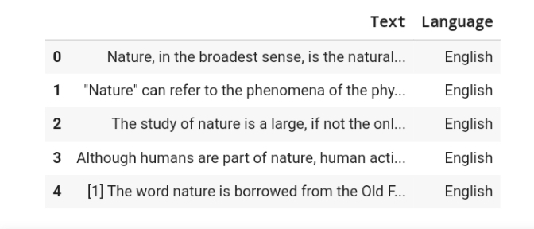
The dataset consists of 2 columns one for the text and other for the language names.
DATA SET SAMPLE

Slide 8
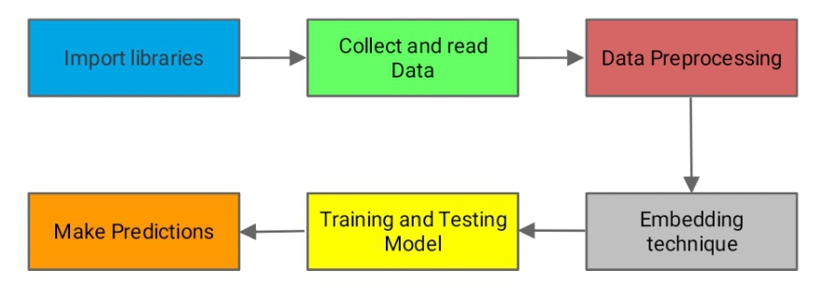
METHODOLOGY & PROCEDURE
Import the required libraries. Read the dataset as .csv file.
Perform missing value treatment by dropping columns with NA values. Remove special characters and numerical from the text.
Add bert glove word embedding layer it aims to generate word embeddings by aggregating global word occurrence matrices from corpus.
Perform one hot encoding representation for input. Initializing model to sequential().
Adding embedding layer that can be used for neural networks on text data. It requires that the data to be integer encoded, so that each word is represented by unique value. It is initialized with random weights. Add LSTM and dense layer.

Slide 9
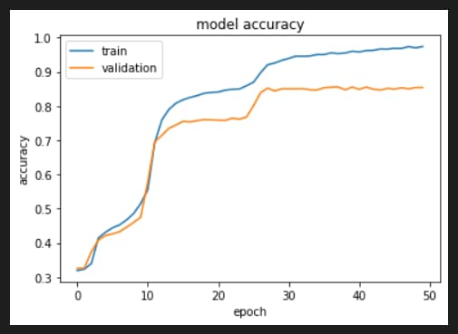
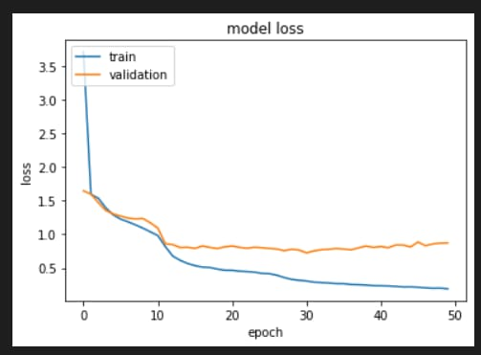
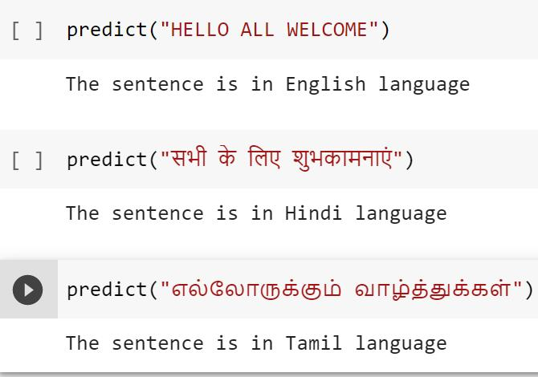
RESULTS
MODEL ACCURACY GRAPH
MODEL LOSS GRAPH
PREDICTION

Slide 10
CONCLUSION
India we have a large number of native languages like each ad every state has its own native language. But most of the people knew only few languages apart from their mother tongue. So the Language identification/detection gained an importance. So that we developed an application that is used to identify the language name from the given input text. It is very useful to identify the language names in a multilingual document. The model performed very well in identifying the languages with an accuracy of 97%. In future the application can be developed to identify and translate the text from one language to the other language.

Slide 11
LITERATURE REVIEW
PAPER TITLE | AUTHOR NAME | ALGORITHM USED | ACCURACY
Native Language Identification with L1-influence Metrics | Julian Brooke and Graeme Hirst. | Ngram language model | 95%
ExpLoring Syntatic Features for Native Language Identification | Serhiy Bykh and Detmar Meurers | LSTM | 92.6%
Serhiy Bykh, Sowmya Vajjala, Julia Krivanek, and Detmar Meurers | Combining shallow and linguistically motivated features in native language identification | Multinomial Naive Bayes | 96%
Radu Tudor Ionescu | A Fast Algorithm for Local Rank Distance: Application to Arabic Native Language Identification | LSTM | 93%
Lan Wang, Masahiro Tanaka, and Hayato Yamana | Improving Chinese Native Language Identification by Cleaning Noisy Data and Adopting BM25 | Naive Bayes | 98.1%

Slide 12
REFERENCES
[1] Julian Brooke and Graeme Hirst. 2020. Measuring Interlanguage: Native Language Identification with L1-influence Metrics. In Proceedings of Language Resources and Evaluation (LREC). pages 779–784.
[2] Serhiy Bykh and Detmar Meurers. 2019. Exploring Syntactic Features for Native Language Identification: A Variationist Perspective on Feature Encoding and Ensemble Optimization. In Proceedings of COLING 2019, the 25th International Conference on Computational Linguistics: Technical Papers. Dublin, Ireland, pages 1962–1973.
[3] Serhiy Bykh, Sowmya Vajjala, Julia Krivanek, and Detmar Meurers. 2018. Combining shallow and linguistically motivated features in native language identification. In Proceedings of the Eighth Workshop on Innovative Use of NLP for Building Educational Applications. Atlanta, Georgia, pages 197–206.
[4] Radu Tudor Ionescu. 2020. A Fast Algorithm for Local Rank Distance: Application to Arabic Native Language Identification. In Proceedings of the International Conference on Neural Information Processing. Springer, pages 390–400.
[5] Lan Wang, Masahiro Tanaka, and Hayato Yamana. 2019. What is your Mother Tongue?: Improving Chinese Native Language Identification by Cleaning Noisy Data and Adopting BM25. In Proceedings of the International Conference on Big Data Analysis (ICBDA). IEEE, pages 1–6.

Slide 13


